Slide 1
First RP Results obtained during and after the Synchronization test
H. Vincke on behalf of RP

Slide 2
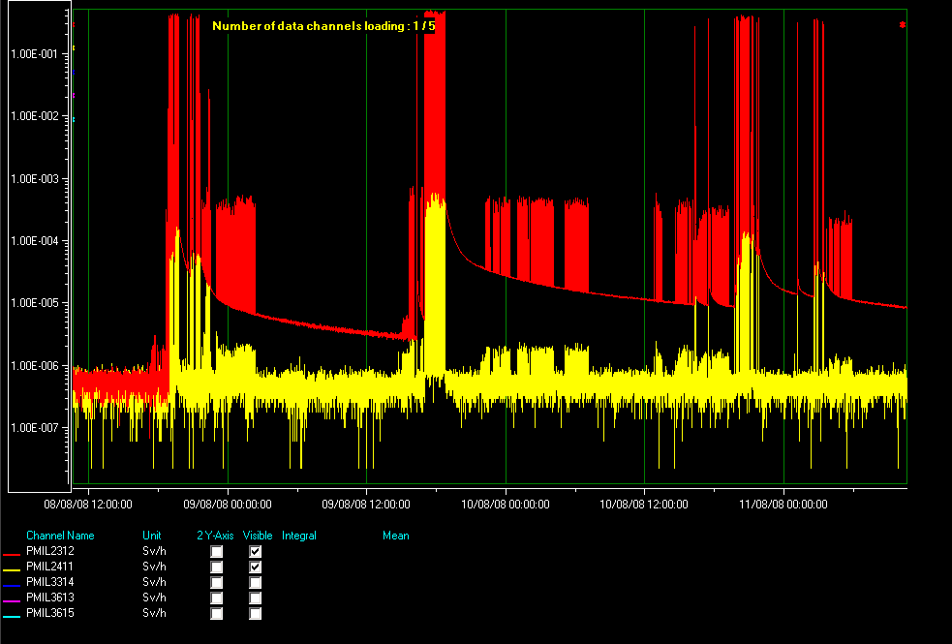
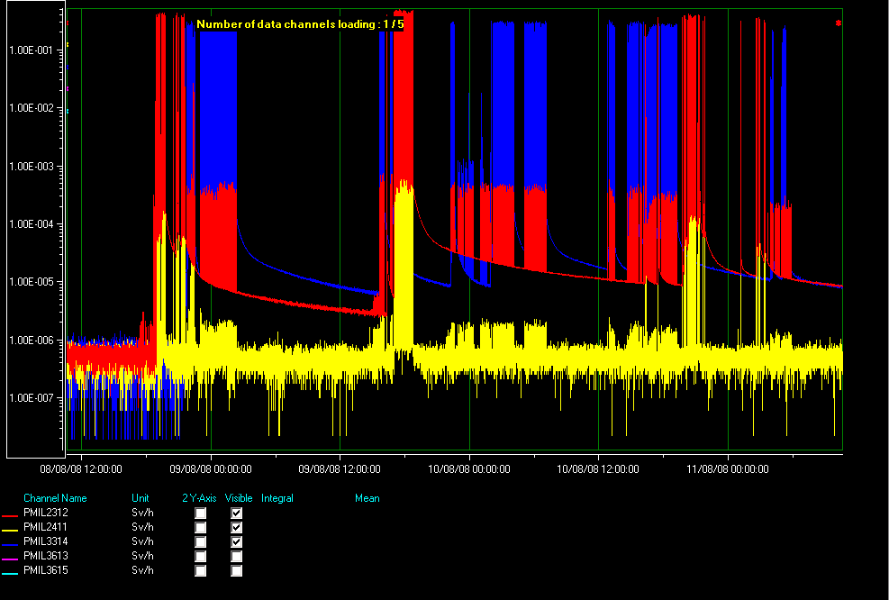
Detektor reading during the test (RA23 + ALICE)
PMI at TDI absorber (red)
PMI detector in Alice (yellow)
PMI detector at the secondary collimator in Point 3 (blue)

Slide 3
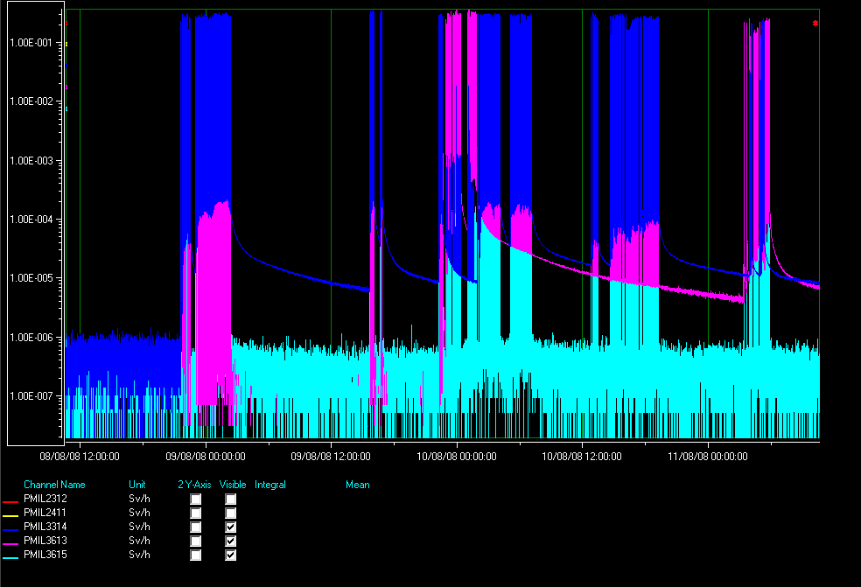
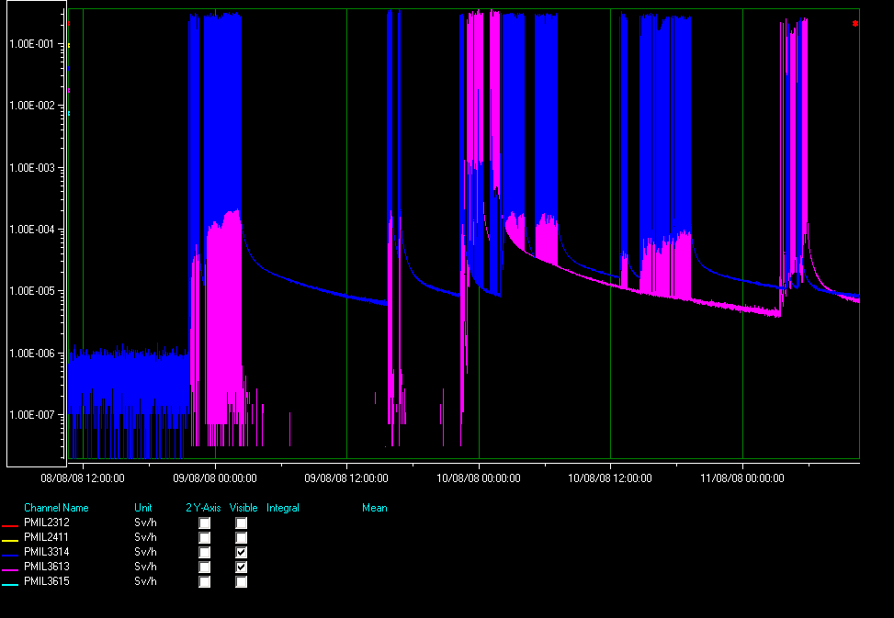
Detektor reading during the test (Point 3)
PMI at secondary collimator
PMI at TCLA collimator
Last PMI in Point 3 (towards direction Point 4)

Slide 4
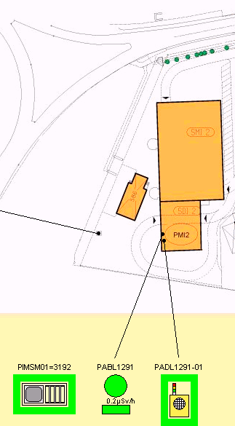
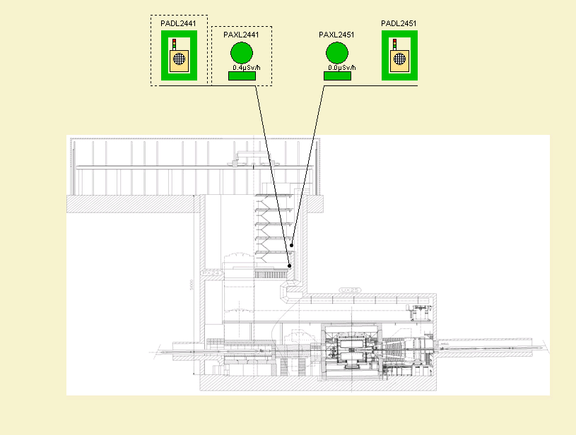
Radiation levels at accessible areas during the test
Surface of PMI2 shaft
ALICE counting rooms

Slide 5
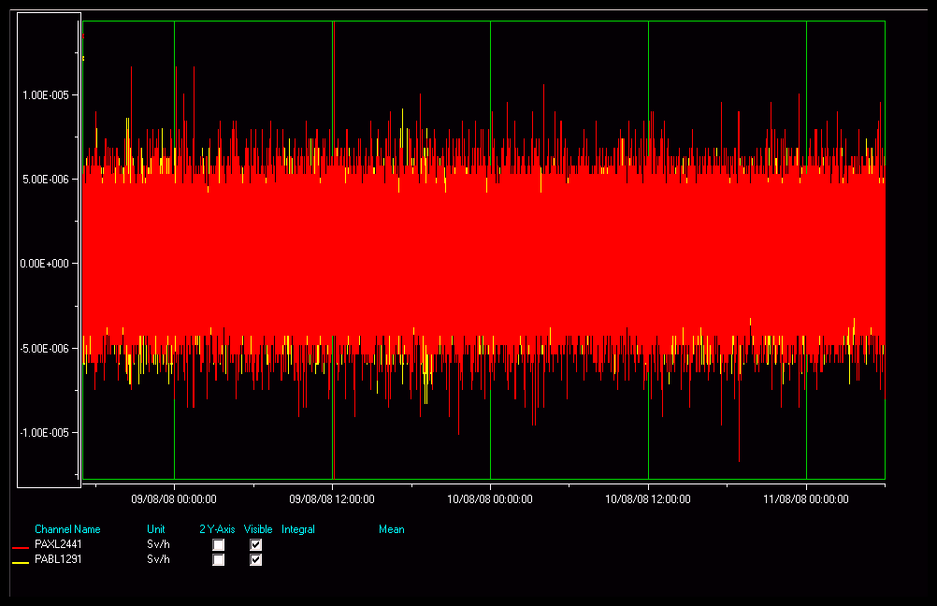
Radiation levels during the test
Alice counting rooms and top of PMI2 shaft: Background

Slide 6
LHC Area Classification after the Synchronization Test
R22 to Alice: Supervised Radiation Area (since 12/8/08 including also area around TDI)
ALICE detector area: Supervised Radiation Area
Between ALICE and Point 3: Supervised Radiation Area
Point 3: Currently Limited Stay Area (Radiation Veto “on”), radiation survey done.
maximum dose rate: 80 uSv/h (12/8/08)
Between Point 3 and 4 (downstream sector doors at R37): Non Designated Area

